Slide 1
Correlation Between Poverty and Drug Overdose Rates in the United States
Dan Sinda, David Adurogbola, Isaac Becker, and Alex Stephens

Slide 2
Motivation
Hypothesis: There is a POSITIVE correlation between Overdose Rates and Poverty Rates in the United States.
Questions we asked:
What state(s) have the highest drug overdose and poverty rates?
Any limitations to the data statistics and analysis?
If there are outliers what can we learn from them?
Future considerations?

Slide 3
Data Framework
Where we found the data:
Centers for Disease Control and Prevention
https://www.cdc.gov/drugoverdose/data/statedeaths.html
Census API
https://www.census.gov/data/developers/data-sets.html
Data Required: State level overdose totals and poverty rates from 2015 - 2019

Slide 4
Data Exploration/Methodology
HeatMap
Bar Chart
Pie Chart
Scatterplot & Line Regression

Slide 5
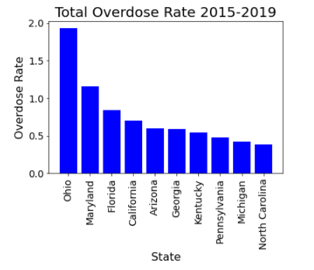
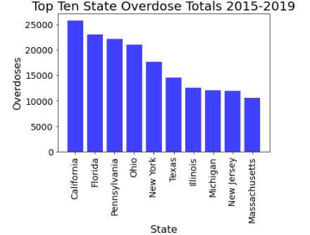
Results/Analysis
Top Ten Overdose Rates and Totals

Slide 6
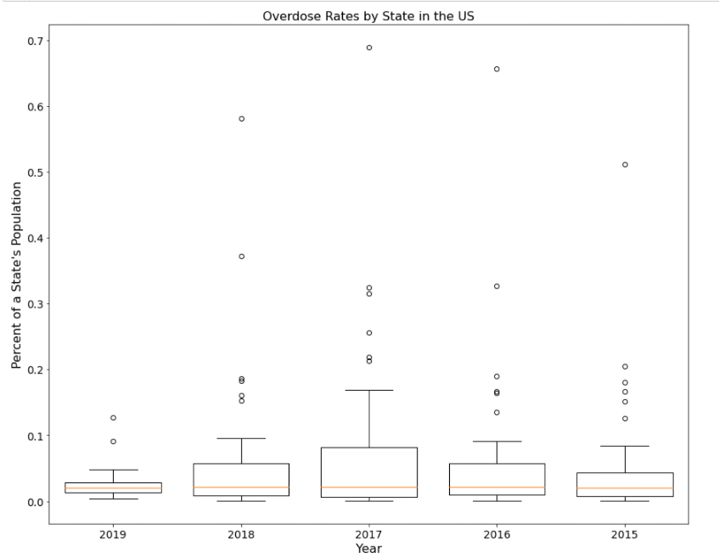
Results/Analysis Cont’d
Box Plots across all five years

Slide 7
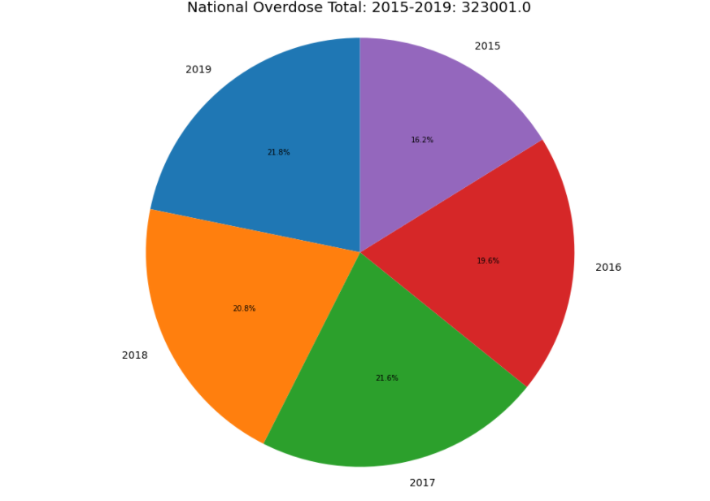
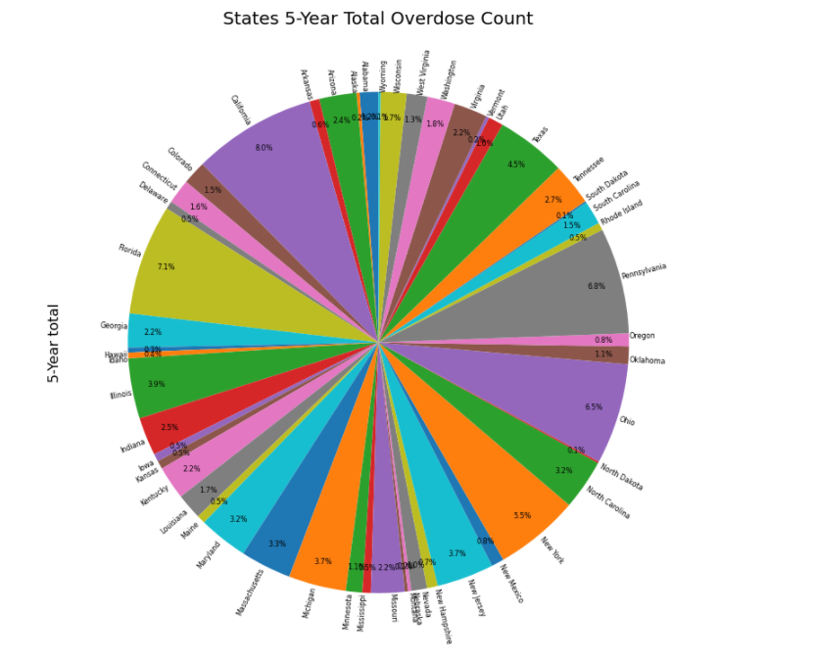
Results/Analysis Cont’d
National Overdose Total: 2015-2019
States 5-Years Total Overdose Count

Slide 8
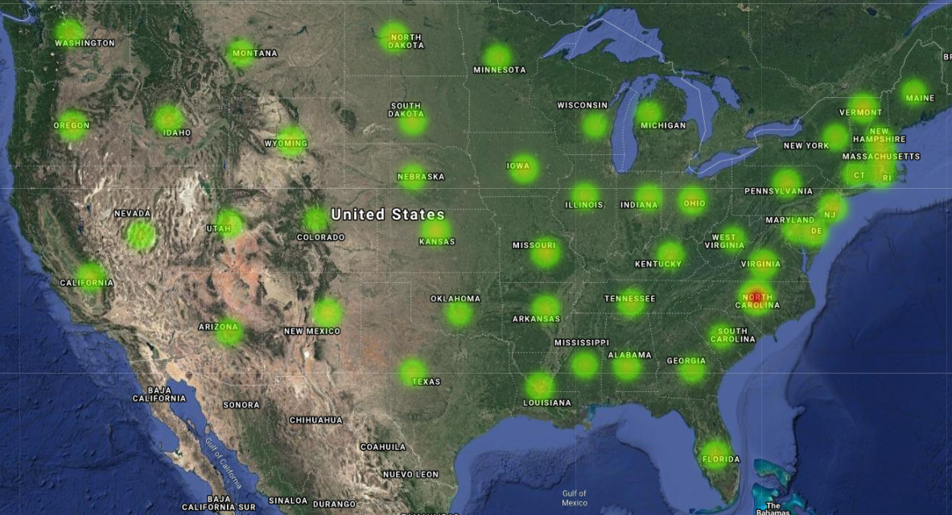
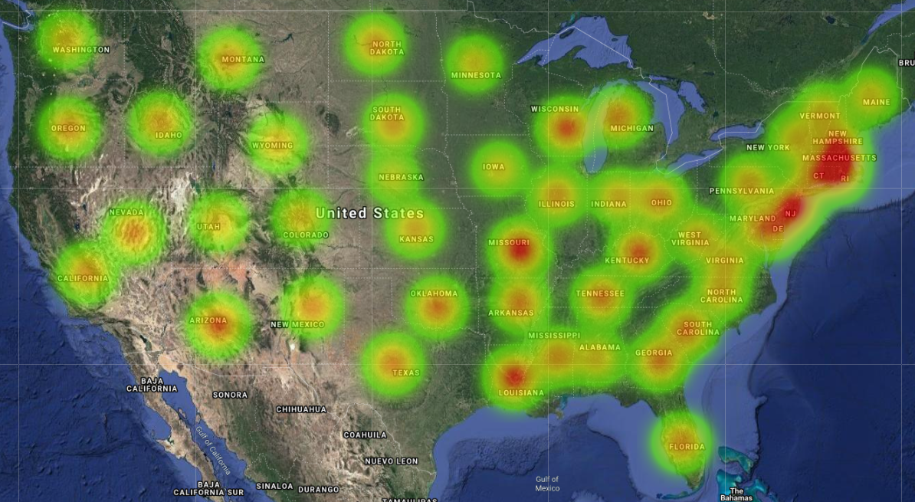
Limitations of HeatMaps and What do Outliers Tell Us?
Issues with outliers.

Slide 9
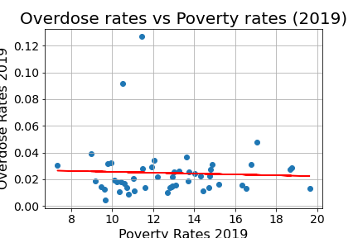
Discussion/Future Considerations
Overall Top 10 Poverty Rate States: NE, NY, AL, MS, NM, LA, VT, VA, NV, & PA
Overall Top 10 Overdose Rate States: OH, MD, FL, CA, AZ, GA, KY, PA, MI, & NC
Regression Line Equation = y = -0.0003x + 0.03
R² = 0.002068949456997716
Conclusion: NEGATIVE correlation between Overdose and Poverty rates in all years. For future considerations, we should consider testing Overdose rates against States or Cities with higher medical costs to determine if there is a positive correlation between these factors.

Slide 10
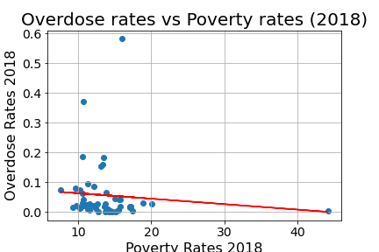
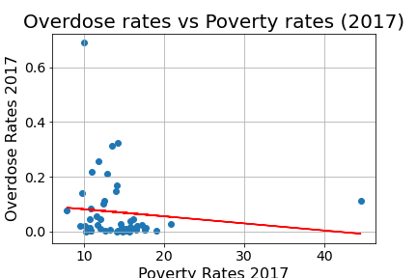
Discussion Cont’d Overdose vs. Poverty Rates 2018 & 2017

Slide 11
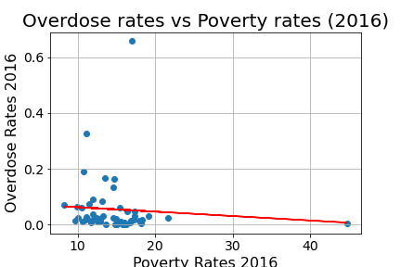
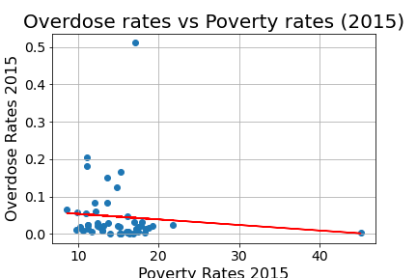
Discussion Cont’d Overdose vs. Poverty Rates 2016 & 2015

Slide 12
Questions?

